Slide 1


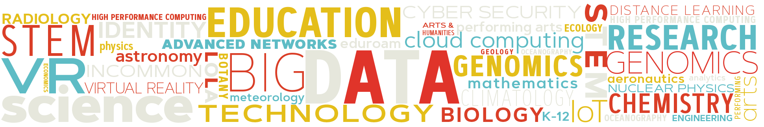
UPDATE: Exploring Clouds for Acceleration of Science
NSF Award #1904444.
Jamie Sunderland

Slide 2


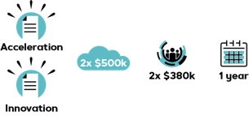
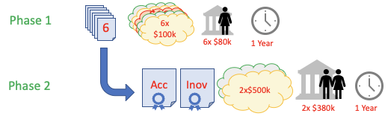
E-CAS: Exploring Clouds to Accelerate Science
NSF Award #190444 under a Cooperative Agreement with Internet2 : $3,030,955; 11/2018-10/2021
Phase 1
Cloud providers support 6 teams with $100k each of credit to develop and demonstrate computational science at scale
A panel of academic reviewers select best 2 in terms of acceleration of science and innovation
Objectives
Test effectiveness of commercial cloud for large scale research
Use accelerated hardware such as FPGA and GPUs
Explore Cloud AI and Machine Learning frameworks
Explore cloud provisioning and management of resources
Examine performance metrics and identify gaps
Phase 2
2x NSF Awards of $500k + staff + F&A
Notes:
Okay, just a little intro the E-CAS project and then I’ll go through a couple of examples of projects using the Google Cloud Platform.
E-CAS is a project to explore commercial cloud platforms to see how they can be used to accelerate science by leveraging the Scaling abilities and access to new and emerging technologies. The project is managed by Internet2 under a cooperative Agreement with NSF; and is supported by Google Cloud Platform and Amazon Web Services.
The structure of the program is somewhat like a startup competition; except each of the teams involved already have very significant research profiles and have research prototypes in development. In December 2018, Internet2 released a request for proposals for the E-CAS project. From the 20-odd proposals that were submitted, 6 were selected through an external academic review panel to participate.
Phase 1 of the project is generously supported by the cloud providers donating up to 100,000 dollars worth of cloud credits to each of the teams to spend a year developing their projects to demonstrate how they can accelerate science in their field through scale or innovation using the commercial cloud platforms. During this first phase they also have some partial staff support funding provided by NSF through a sub-award.
At the end on phase 1 each team provides a written report and a presentation of their work describing how the project enabled them to progress their scientific research and how it might also have broader impact for the scientific community. Then, again using an external academic review panel, 2 of these teams will be awarded up to 500,000 dollars each to spend on Cloud Services and some further staff funding to continue their projects at scale for another year.
The six teams involved are on the next slide.

Slide 3
E-CAS Phase 1 projects.
SUNY Brain Research: Complex Simulations using >100,000 CPUs
Purdue Building Clouds: Image processing using ML and weather modeling
MIT LHC Computing: Accelerated Machine Learning as a service.
UW Madison IceCube: Multi-cloud GPU farms using OSG. >50,000 GPUs
GW BioCompute Objects: Open & Reproduceable Galaxy/HIVE workflows.
SDSC CIPRES gateway: Bursting for GPU acceleration and long-runs.
Details, Link to webinars on each at https://internet2.edu/ecas
Notes:
1. Deciphering the Brain’s Neural Code, which seeks to understand how the brain stores and transmits information through complex simulation of the brains neural cortex and comparing that with experimental observations.
2. The Building Clouds” project seeks to provide a method for creating a detailed model of the worlds major urban centers including meta-data on the structure of buildings obtained through images to aid in urban planning, climate modelling and weather forecasting.
3. MIT are working with Fermilab and the people at CERN in Switzerland to develop methods for processing huge data-flows to find small interactions such as a Higgs-Boson and potentially new physics.
4. The Ice-Cube project which has a facility at the South Pole which detects astronomical neutrinos.
5. The George Washington project on Bio-Compute Objects which seek to standardize packaging of data and computational workflows for repeatability and verification, particularly in genomics and drug development.
6. CIPRES is a phylogenetic science gateway hosted at the San Diego Supercomputing Center which enables users to compare genetic sequencing data between species and organisms to understand their evolutionary biology.

Slide 4
The project process – how has it gone so far?
Getting started: Took MANY people.
The solicitation and selection of phase 1
Timing and effect on proposals
Selection of Phase 1 projects – Peer Review
Contracting sub-awards
Accounts and credit distribution
Bi-weekly meetings and monthly reports

Slide 5
Some observations from phase 1.
Teamwork – The important role people play!
The people-power needed for the project was much greater than the need for credits – although for most groups the credits are easily spent.
Most had no dedicated RSE – researchers doing sysadmin tasks.
Development work takes longer than expected. Esp CPU->GPU porting.
Learning new tools, environments as you go.
Challenging when also trialing novel computational/scientific methods.
Working with University IT. Security audits, Account management ..etc. Different experiences for different projects.
Notes:
Esp

Slide 6
Cloud Platforms (In general)
Enormous range of branded technologies to try to comprehend and select from. Multiplied by Open-Source add-ons. (A whole new language)
Many new offerings have very limited documentation and support at a deeper technical level can be poor (even with paid support contracts).
Some teams found the best support came from online user forums.
Accounts have resource limitations. At some levels this required support tickets to increase limits; but at very large scale this required a level of “social engineering” and coordination with cloud providers.
A “hidden layer” of technologies between the VMs and the hardware can make it hard to diagnose performance issues. Some issues remain unexplained.

Slide 7
Examples of technical issues
Data movement. Disk mounting and latency issues. Managing permissions.
Software component version mis-matches.
Pre-emptible machine architectures save money/credits but need fault tolerant code.
Inter-node latency issues. (Same zone vs Placement groups)
Difficulty getting >100 nodes in the same region/zone.
Access to hardware switches, such as disabling hyperthreading.
Software libraries in machine images and version compatibilities between components
Notes:
Same region

Slide 8
Some key technical achievements
Large scale models. 100,000 CPU cores in GCP – Using SLURM+GKE
Long simulations. 10,000 cores x 2 weeks (1.8M core hours)
Large scale GPU farms using OSG/HTCondor >50,000 GPUs
Accelerated ML “As a Service” using FPGAs, GPUs and gRPC calls.
Cloud GPU acceleration of photogrammetry for public submission.
Dynamic bursting of CIPRES jobs from Comet to AWS using faster V100 GPUs. Free-up comet resources and quotas. Allowing longer job runs.
Bicompute Object Library and Galaxy instance open to public on AWS. Pre-submission resource/cost estimate tools.
Direct NSF mount over I2 Cloud Connect / AWS Dx.

Slide 9
Selection of Phase 2 projects.
All teams provided a presentation to a Virtual Workshop in April.
Written reports and proposals for Phase 2 submitted end of April.
Sent out to peer review in May
Reviews collated and discussed by the Advisory Board over several meetings in June.
Teams advised of recommendation in July.
Sub-award contracts have been issued.
Phase 2 due to start in August. (Runs 1 more year, each team has up to $500,000 in cloud spend and $330k in staff and indirect charges).
Expect a public announcement this week. Teams selected are MIT and SUNY.

Slide 10
Some key scientific achievements of selected teams
MIT developed a range of new algorithms using FPGAs and GPUs for Deep Learning Neural Networks that can can be called as remote procedures. This innovation will help design the next generation of processing for LHC and could be more broadly applied as a methodology for incorporating ML into workflows. MIT have run workshops on accelerated ML with Fermilab.
SUNY was able to incorporate evolutionary algorithms into much larger models with longer simulation times than previously possible. Completed long-run neuronal avalanche simulations. Reproduced and explained mechanisms of motor cortex oscillations and molecular/drug effects leading to movement. Each of these achievements leading to scientific publications.

Slide 11
Time to discuss…. More information: https://internet2.edu/ecas CLASS: Cloud Learning and Skills Sessions. https://internet2.edu/class NET+ : https://www.internet2.edu/cloud-services and of course: CCCG. https://www.educause.edu/community/cloud-computing-community-group

